Slide 1
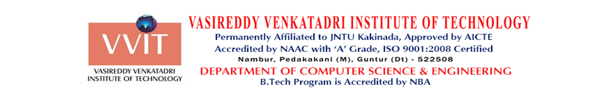
Real Estate Management
(Review 01: Abstract, Introduction, Design)
Project Guide:
Mr. M. Gnana Vardhan
(Assistant Professor)
Batch: A03
Members:
1. B.Divya Sri Lakshmi-22BQ1A0522
2. CH.Naga Venkata Mani Deepthi-22BQ1A0538
3. A.Ayeesha Farheen-22BQ1A0501
4. CH.Koti Surya Prakash-22BQ1A0537

Slide 2
Abstract:
The project aims to create an intuitive and scalable real estate platform that facilitates interactions between renters, buyers, and property owners. It is structured into four core modules: User Management, Property Management, Search and Interaction, and Admin Panel. The platform integrates essential features such as property listing, searching, user communication, and administrative oversight, ensuring a smooth real estate experience.
Developed using modern web technologies, the platform utilizes React for a dynamic and interactive front-end interface and Flask for a reliable and scalable back-end framework. The integration of various APIs enhances functionality by providing up-to-date property listings, user interactions, and market trends. The system is built to be responsive, adaptable, and scalable, ensuring it can evolve to meet future user needs and market demands.

Slide 3
Problem Statement:
Managing real estate properties is a complex and time-consuming task for property owners, agents, and tenants. Challenges include maintaining accurate property records, streamlining communication, handling payments, and ensuring transparency in transactions. Traditional methods often lack centralization and efficiency, leading to mismanagement and client dissatisfaction. A comprehensive, role-based real estate management system is needed to simplify property listings, automate processes, and improve collaboration among stakeholders.

Slide 4
Objectives:
The primary goals of this application are: Simplify Real Estate Transactions, Enhance Communication, Centralized Management, Improve Transparency.
For Property Owners: Saves time and effort by automating property management tasks.
For Tenants/Buyers: Makes property discovery and communication easy and accessible.
For Agents: Increases efficiency by streamlining property promotion and customer interactions.
For Admins: Provides tools to maintain the platform's security and usability.

Slide 5
Modules:
1.User Management Module: Manages user authentication, role-based access, and profile management for tenants, owners, agents, and admins
2.Property Management Module (Owner-Centric): Enables property owners to list, edit, and manage their properties, track inquiries, and view property performance.
3.Communication & Reviews: Facilitates seamless communication between users and allows tenants, owners, and agents to leave reviews and ratings for properties and interactions.
4. Admin Module: Allows administrators to oversee platform operations, manage users, moderate content, and generate system analytics.

Slide 6
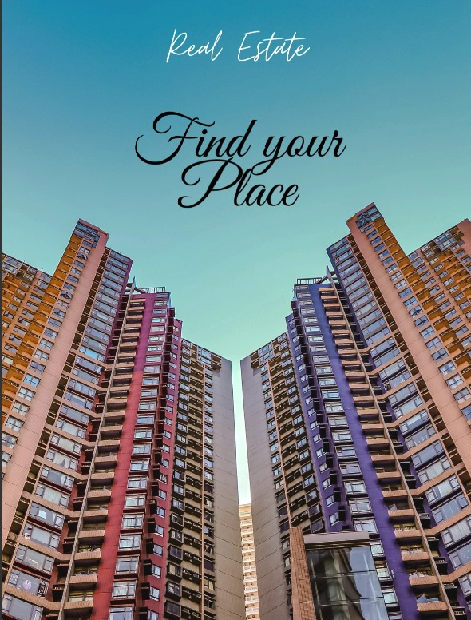
Module 1:User Management Module
Features:
User Login/Register
Search and Filter Listings
View Listing Details
Save Favorite Listings
View Map with Listings
Change Profile Information
User Notifications
Rating Listings

Slide 7
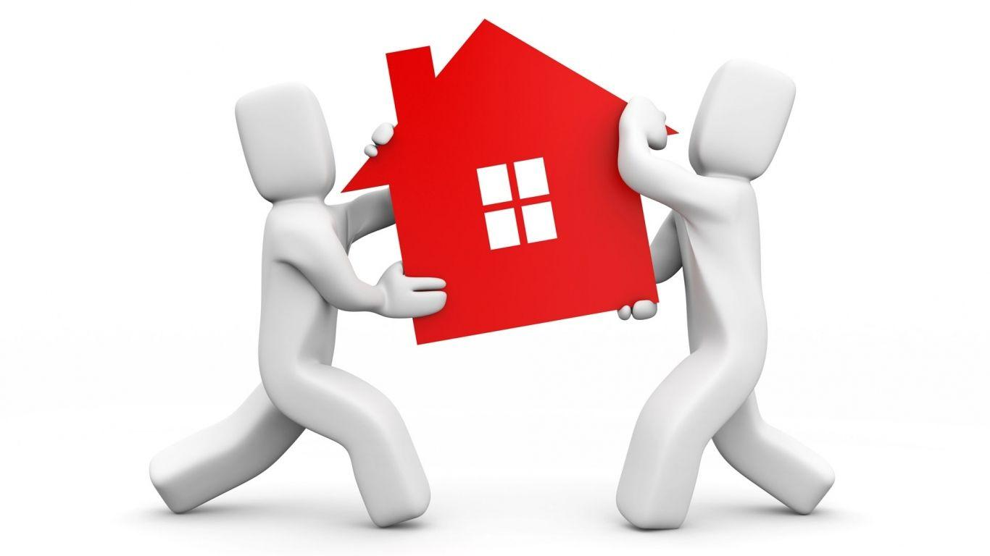
Module 2: Property Management Module
Features:
Owner Registration/Login
Create New Listing
Edit/Delete Listings
Manage Listing Availability
Send Messages to Buyers
Owner Profile Management
View All Own Listings
View Listing Details

Slide 8

Module 3: Communication & Reviews
Features
Messaging System Between Buyer and Owner
View Previous Messages
Real-Time Message Notifications
View Property Ratings
Review System for Owners
Report Inappropriate Listings or Users
Filter Listings by Rating
Block/Unblock Users

Slide 9

Module 4: Admin Module
Features:
Admin Login and Authentication
View All Users
Suspend/Activate User Accounts
View All Listings
Approve/Reject Listings
View Platform Analytics
System settings
Send System-Wide Notifications

